Slide 1

FINAL REPORT CAPSTONE (DATA 2206) REPORT ON CANNABIS PLANT FOR STARSEED INC.
Prachi Jindal | 100721507 | April 17, 2020

Slide 2
AGENDA
Overview
Key Questions
Data Analysis
Conclusions
Further Questions
References
Appendix
Notes:
The report here covers overview of the project, key questions that this report will answer, data analysis conducted to prepare data for model analysis and analyse results of the data, conclusion of the data analysis, further questions, references and appendix.

Slide 3
OVERVIEW
PROBLEM STATEMENT
Predict the “best” quality strain composition and plant size of cannabis strain to manufacture high potency medicinal cannabis products.
ANALYTICS RATIONALE STATEMENT
To classify and identify the best composition and plant size of the strains which potentiate the effect of THC and CBD to manufacture high potency medicinal cannabis products using those strains and market the best cannabis to potential users.
Notes:
The overview has problem statement and analytical rationale statement

Slide 4
KEY QUESTIONS
KEY QUESTION - 1
How accurate is the model to classify the best strains?
The data is analysed using machine learning models to classify the best strains which makes important for model to get results with highest performance metrics. The best results will make sure that the model was best to analyse the data and classify the best strains
KEY QUESTION - 2
How to maintain consistency in quality of strains to potentiate the effect of THC and CBD which will be used to produce premium medical cannabis products?
To identify the model where the performance metrics get better
KEY QUESTION - 3
How Starseed Inc can increase revenue by attracting more customers and retaining the existing customer base to buy premium products?
Starseed Inc will have a process to identify and classify the best strains which will make them produce premium quality cannabis products. The quality of strains and the credibility of classification process will get more customers and retain existing customers. Th other strains can be put to other use and the company can benefit from that as well.
Notes:
This slide has three key questions and the reasons why this questions need to be answered. The questions asked here will be later answered from the results produced by data and model analysis.

Slide 5
SCORE CARD
Objective | Measure | Target Level
Data Model Performance Metrics
Identify best-strain cannabis, correct classification will give the best strain to be used for medical purposes | Recall | >95%
 | Precision | >95%
 | Accuracy level to classify best strains | >95%
Customer focused business processes
Value for money and quality | Customer satisfaction | Up to 100%
 | Customer retention | Up to 60%
Internal Business Processes
Correct Classification to improve the supply of high-quality strain | Correct classification will lead to correct chemical composition required | Recall metric will serve as an indicator to further investigate on this
Financial
Increased profit | More revenue and sales by delivering the premium medical product using best strains to customers |  | By 60%
Business Opportunity
To explore other domains like venturing into recreational sector | CBD Oil Potency | More research needed to evaluate other utility categories to use for business purposes
Notes:
The analytical score evaluates objectives of this report, measures and their target levels.
The first objective is to evaluate data model performance metrics The target to get true positives is greater than 95% since the best strains have to be identified for the project. Accuracy level is targeted to be no less than 95% since the model needs to classify best strains. The precision value is targeted at greater than 95% to successfully get the relevant results on model performance.
The customer satisfaction and retention level is targeted at 100% and 60% respectively.
The revenue is aimed to increase by 60%

Slide 6
DATA ANALYSIS
Notes:
Now, the coming slides will talk about data anlaysis

Slide 7
The dataset is provided by Starseed Medical Inc, the data set has nine features and one outcome variable.
The dataset is analyzed for characteristics that shows that dataset has 1472 rows
The outcome variable ‘Utility’ has five categories – none, low, average, good and best. The dataset is converted to binomial – ‘best’ and ‘other’ The classification is done combining none, low, average and good to ‘other’ class and assigning class 0 and best quality will be classified to Class 1.
The data has missing values marked as ‘?’ and some data values are marked as NaN
UNDERSTANDING
THE DATA
Notes:
The dataset is provided by Starseed Medical Inc. and has nine features and one outcome variable. The outcome variable ‘utility’ will be converted to binomial ‘best’ and ‘other’ The classification is done combining none, low, average and good to ‘other’ class and assigning class 0 and best quality will be classified to Class 1.

Slide 8
RESULTS - EXPLANATORY ANALYSIS
The dataset is left with 1334 rows with 9 features after dropping rows with NaN values. This point reflects no missing values in dataset. The data types are changed to float for all the features
The dataset was converted to binomial data which was used to create pie chart where the data reflected presence of imbalance towards ‘best’ strain class
There was noticeable correlation between some features of the dataset where one of the variables can be dropped since two of the variables have linear relationship
Notes:
The ‘?’ values are replaced with 0 and NaN values are replaced with median for 5 features and rows with more than 50% NaN values are dropped. After dropping rows and replacing values, 1334 are remaining.
Some of the features are correlated and can be dropped since two of the variables have linear relationship

Slide 9
METHODS FOR ANALYSIS
RE – INDEXING
After dropping rows with more than 50% NaN values, the entries are re-indexed
REMOVING OUTLIERS
Tukey Method is used to remove outliers from the data set and rows with more than two outliers are dropped
SMOTE
SMOTE is used to balance the proportion of output classes by creating synthetic data. This helps to protect the model from bias
COMPARISON MODEL
MODEL CREATION
MODEL EVALUATION
Notes:
The rows are re indexed after dropping rows with more than 50% NaN values
Tukey Method is used to remove outliers from the data set and rows with more than two outliers are dropped
SMOTE is used to balance the proportion of output classes by creating synthetic data. This helps to protect the model from bias against class 1 which has much lower number of rows compared to class 0
Comparison model was used to analyse which model can give best possible results
Model is created and evaluated to get the results of performance metrics

Slide 10
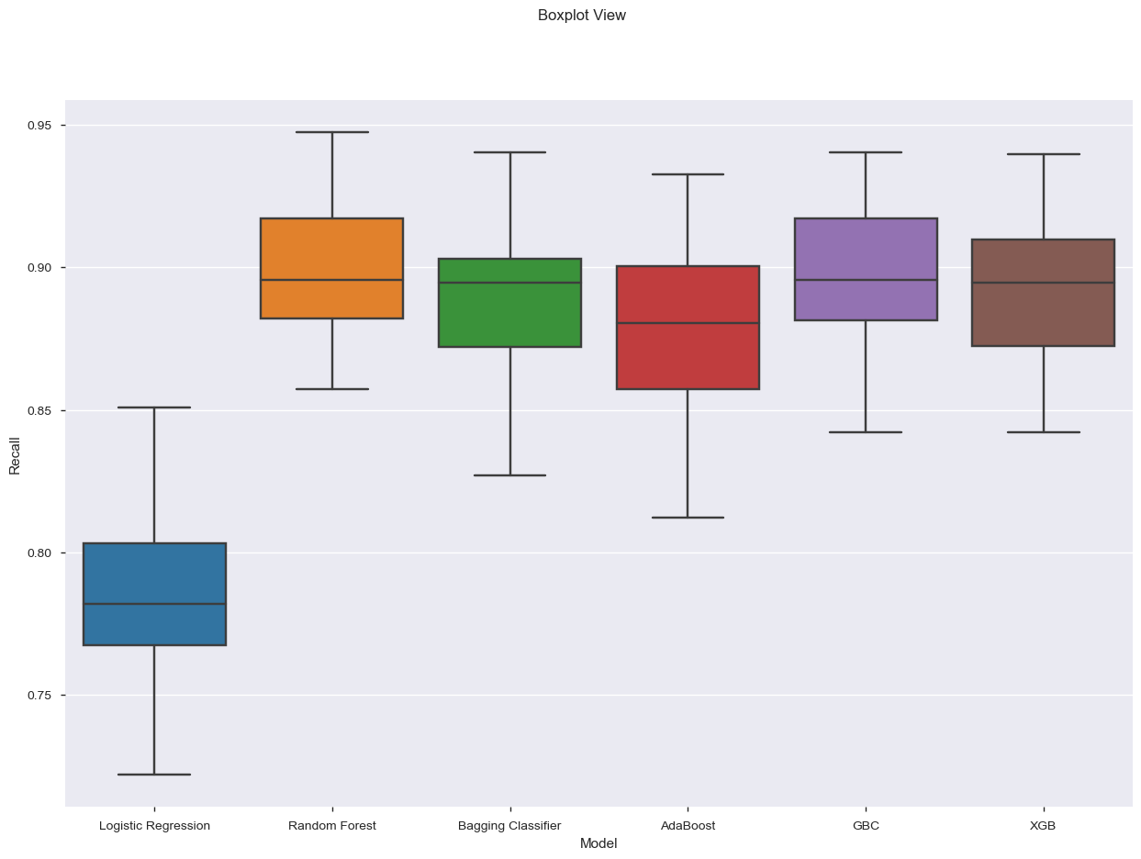
MODEL ANALYSIS – comparison model
Random Forest will be used as our base model and Random Forest with grid search will be used for analysis. The reason for choosing Random Forest Model is that it does feature selection automatically and the randomized parameters does not affect performance of model.
Random Forest
Gradient Bagging Classifier
Notes:
For our base model, the model with highest recall value, precision score and accuracy score will be chosen, and the metrics show that
Random Forest has highest accuracy 90% ± 02%.
Bagging Classifier has highest accuracy 90%% ± 02%
Random Forest will be used as our base model and Random Forest with grid search will be used for analysis. The reason for choosing Random Forest Model is that it does feature selection automatically and the randomized parameters does not affect performance of model.

Slide 11
OPTIMIZED RANDOM FOREST MODEL WITH GRIDSEARCH
NestedCV Recall Value
0.91%±0.01
>95%
TARGET VALUES
FROM SCORECARD
NestedCV Precision Value
0.91%±0.02
>95%
NestedCV Accuracy Score
0.91%±0.01
>95%
The analysis gave the NestedCV Recall Value of 0.91%±0.01 which is good except the minimum of 95% correct prediction of best strains is the aim here. The precision value again is 0.91%±0.01 which is less than targeted precision score. The accuracy of 91% is an improvement over previous result but less than the target of 95%.
Notes:
The NestedCV Recall Value of 0.91%±0.01 is good except the minimum of 95% correct prediction of best strains is the aim here. The precision value again is 0.91%±0.01 which is less than targeted precision score. The accuracy of 91% is an improvement over original model.

Slide 12
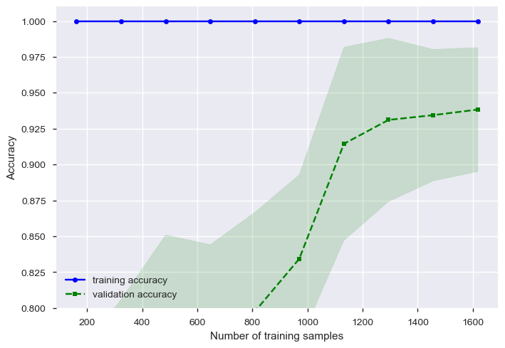
Learning curve
The plot tells how much the dataset can benefit from adding more training data and whether the estimator suffers more from a variance error or a bias error.
The training accuracy score is greater than the validation accuracy score for the maximum number of training samples, adding more training samples will most likely increase generalization which implies that the model can benefit from more training samples.
Notes:
Learning Curve is created to get test and train accuracy and to analyse the fit of the model.
The plot below tells how much the dataset can benefit from adding more training data and whether the estimator suffers more from a variance error or a bias error.
The training accuracy score is greater than the validation accuracy score for the maximum number of training samples, adding more training samples will most likely increase generalization which implies that the model can benefit from more training samples.

Slide 13
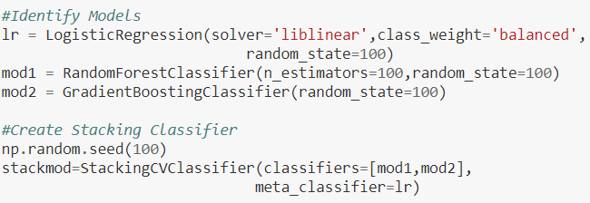
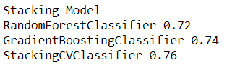
STACKING CLASSIFIER MODEL
The Stacking Classifier model will use Random Forest and Bagging Classifier to check if the results have better recall value, precision value and accuracy score.
Logistic Regression model is used as meta classifier model and Random Forest and Bagging Classifier Models are used as two models for Stacking Classifier.
The accuracy score of Stacking Classifier is 76% which is lower than Random Forest Classifier results
Notes:
The stacking model is an ensemble algorithm that is used here test the accuracy since our previous model did not get the desired results.
Logistic Regression model is used as meta classifier model and Random Forest and Bagging Classifier Models are used as two models for Stacking Classifier.
The mlxtend.classifier is imported and stacking model is evaluated
The accuracy score of Stacking Classifier is 76% which is lower than Random Forest Classifier results

Slide 14
STACKING CLASSIFIER MODEL
TARGET VALUES
NestedCV Recall Value
0.89±0.02
>95%
NestedCV Precision Value
0.89±0.02
>95%
NestedCV Accuracy Score
0.89±0.02
>95%
Result:
The Stacking Classifier model performs poor as compared to Random Forest GridSearch Model with Optimization.
Notes:
The recall value for Optimized Stacking Classifier is 89% ± 2% . The precision value and the accuracy have the same value of 89% ± 2%. The optimized model performs poor as compared to Random Forest GridSearch Model with Optimization.

Slide 15
Key findings
FINDING 1
The ‘best’ quality strain is used to produce medical product and high Recall-Value, high Precision-Value and high Accuracy Score are the best metrics to classify ‘best’ strains. Optimized Random Forest Model with GridSearch with 91% performs better compared to Stacking Classifier Model
FINDING 2
Random forest reduces overfitting by averaging trees. Correlated features are be given equal importance in the analysis, it is better to select features in repetition. Since correlation is observed among features, it is advised to use some other model
FINDING 3
There was a challenge of high imbalance in data. SMOTE is used to create synthetic data to balance the minority class. However, other algorithm can be used to resample the data or undersampling or oversampling can be used to check how the model performs.
Notes:
The ley finding from the model analysis are summarised here
First, it is found that high Recall-Value, high Precision-Value and high Accuracy Score are the best metrics to classify ‘best’ strains. Optimized Random Forest Model with GridSearch with 91% performs better compared to Stacking Classifier Model
Second, Random Forest Classifier reduces the problem of overfitting by averaging several trees. The correlated features are used and given the equal importance and repeatedly selected features were used rather all the features.
Third, other algorithm can be used to resample the data or undersampling or oversampling can be used to check how the model performs.

Slide 16
recommendations
RECOMMENADTION- 1 | Starseed Inc. to provide more data to solve the problem of imbalanced data. More data will have more variance and better training accuracy and better performance metrics
RECOMMENADTION- 2 | Additional research to get more data to use Optimized Random Forest Model with GridSearch to produce better performance metrics results
RECOMMENADTION- 3 | Starseed Inc to collect data carefully and avoid missing values to increase quality of data
Notes:
One for Starseed Inc. to provide more data to solve the problem of imbalanced data. More data will have more variance and better training accuracy and better performance metrics
Second to conduct some additional research to get more data to use Optimized Random Forest Model with GridSearch to produce better performance metrics results
Third is to carefully collect data to avoid missing or incorrect value to maintain quality of the data

Slide 17
CONCLUSION
Optimized Random Forest model performs well in terms of accuracy. However, the target of 95% with performance metrics was set and Random Forest model managed to get close to 91%.
Additional research and re analysis needs to be done in order to understand how to evaluate data using accurate model in our ensemble model to achieve targeted recall value, precision value and accuracy score.
More data for best quality strain would help balance out the imbalance existing in the given dataset.
Notes:
In conclusion,
For this analysis, Optimized Random Forest model performs well in terms of accuracy. However, the target of 95% with performance metrics was set and Random Forest model managed to get close to 91%.Additional research and re analysis needs to be done in order to understand how to evaluate data. More data for best quality strain would help balance out the imbalance existing in the given dataset.

Slide 18
FURTHER QUESTIONS
QUESTION 1
Can dataset include more features for each type of strain with respect to smell, color, bud structure, etc?
QUESTION 2
Does Starseed Inc has more resources – time and budget to collect more data and reconduct model analysis?
QUESTION 3
Is there any source of verification for the data analysis to verify that model performance is at par?
Notes:
Question one is to see if Starseed Inc. can collect and provide data on more features, of course, the features should make sense.
Question number two is to see if Starseed has the potential or the capacity to devote more resources – time, budget, human capital to reconduct analysis
Third is to see if there is any source of verification for the data analysis to verify that model performance is at par?

Slide 19
REFERENCES
Hyde, W. (2018, January 3). Factors That Impact Your Cannabis Strain: Part 2, Environment. Retrieved from https://www.leafly.com/news/cannabis-101/factors-that-impact-your-cannabis-strain-part-2-environment
Brownlee, J. (2019, December 11). Visualize Machine Learning Data in Python With Pandas. Retrieved from https://machinelearningmastery.com/visualize-machine-learning-data-python-pandas/
VanderPlas, J. (n.d.). Data Indexing and Selection. Retrieved from https://jakevdp.github.io/PythonDataScienceHandbook/03.02-data-indexing-and-selection.html

Slide 20
APPENDIX

Slide 21
ASSUMPTIONS AND CONSTRAINTS
ASSUMPTIONS
The dataset will have missing values which are replaced with 0 and NaN values will be dropped
The dataset will have “best” quality strain classified as Class 1 and all other classes will be grouped to Class 0
The dataset has enough observations available to use SMOTE to balance the data
The outliers will be eliminated to better understand the data and get insights
The confidence interval is considered to be 95% with 0.05 significance level which indicates a 5% risk of inaccurate observations
CONSTRAINTS
The dataset with missing value marked a ? and Nan will be dropped to observe distribution and behavior of features – connected to first assumption– soft constraint
The dataset is changed to binomial which means that no other questions can be answered other than what stated in the problem statement, the data analysis will only predict “best” quality strain – connected to assumption of grouping the “best” quality strain to Class 1 and all other to Class 0 - hard constraint.
The “best” quality strain will be used to manufacture medical cannabis products which doesn’t guarantee that they will be used for medical purposes.

Slide 22
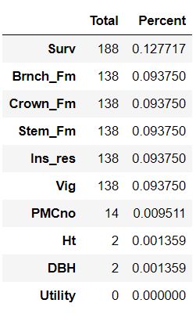
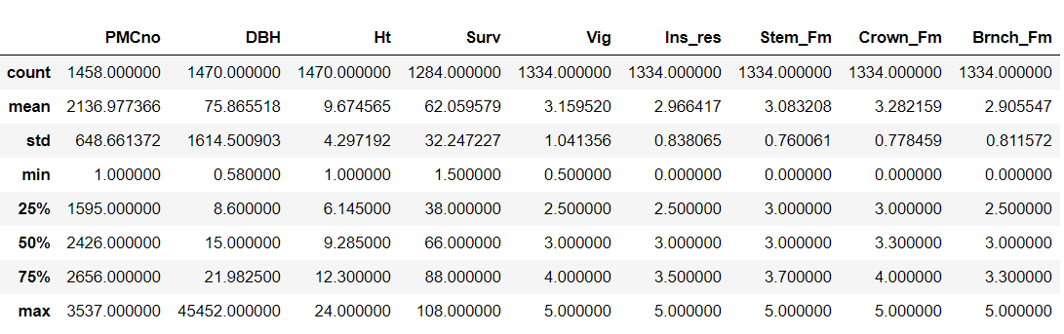
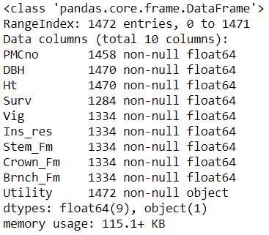
EXPLANATORY DATA ANALYSIS
MISSING VALUES
DATA CHARACTERISTICS

Slide 23
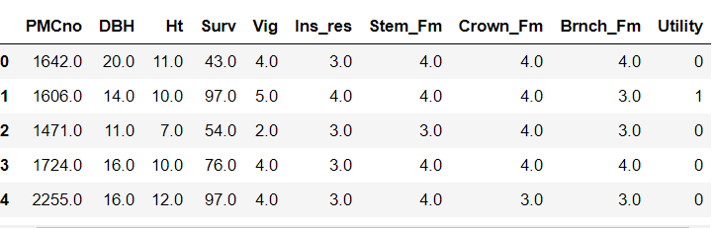
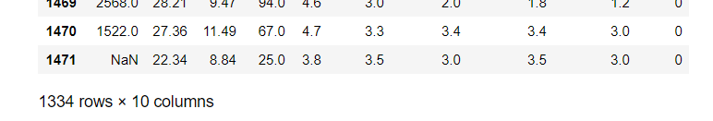

EXPLANATORY DATA ANALYSIS
The outcome variable ‘Utility’ has five categories. The dataset is converted to binomial – ‘best’ and ‘other’ The classification is done combining none, low, average and good to ‘other’ class and assigning class 0 and best quality will be classified to Class 1.
The NaN-missing values will be replaced with Median values. The rows with more than 50% NaN values are eliminated. The threshold is chosen to make sure that the rows, with explaining features, have values where 50 % of the data is NaN should be dropped to get a better dataset for analysis. The dataset has now 1334 rows.

Slide 24
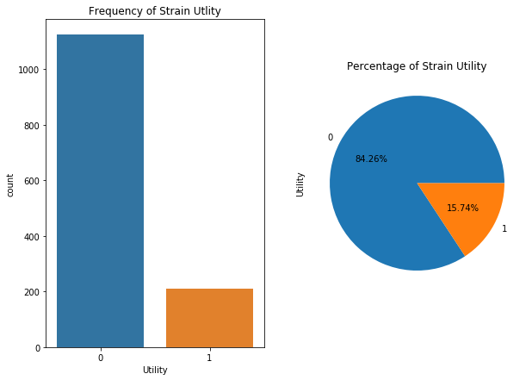
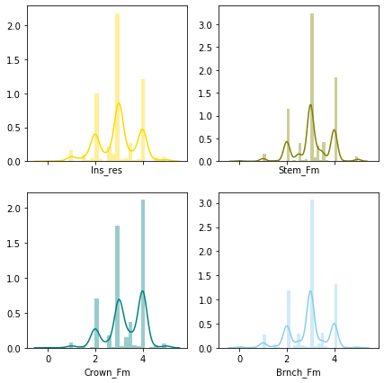
VISUALISATIONs – Explanatory analysis
The above graph represents the distribution of dependent variable, Utility- Best and Other. 84.26% of data for Other(Class 0) strains while we just have 15.74% of data for Best(Class 1) strains. Hence, in order to balance out, SMOTE will be used.
Looking at the above distribution, Branch_Fm. Stem_Fm ,Ins_res and Crown_fm are spread across the centre with majority of the values for these four features ranging between 2 to 4. A Gaussian-like shape to the distribution is observed and is a rough approximation.

Slide 25
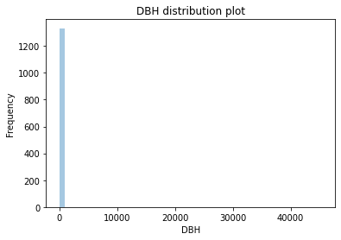
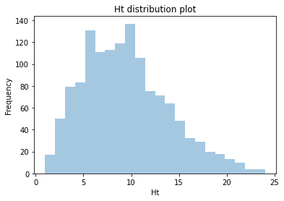
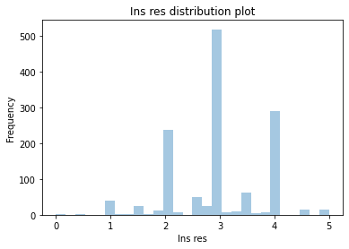
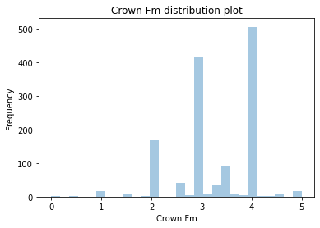
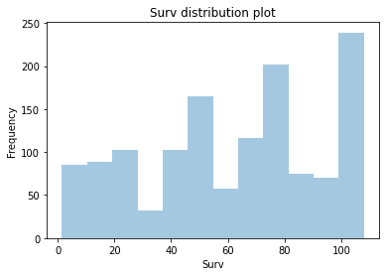
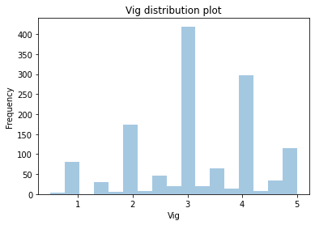
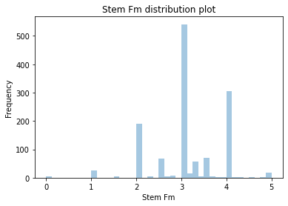
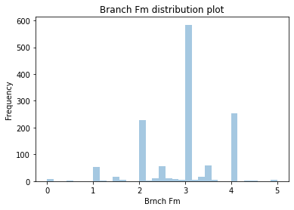
HISTOGRAM PLOT
Looking at the above distribution, Branch_Fm. Stem_Fm ,Ins_res, Vig and Crown_Fm are widely spread across the center. Ht is skewed and Surv is spread wide across with a bit skewness toward right.

Slide 26
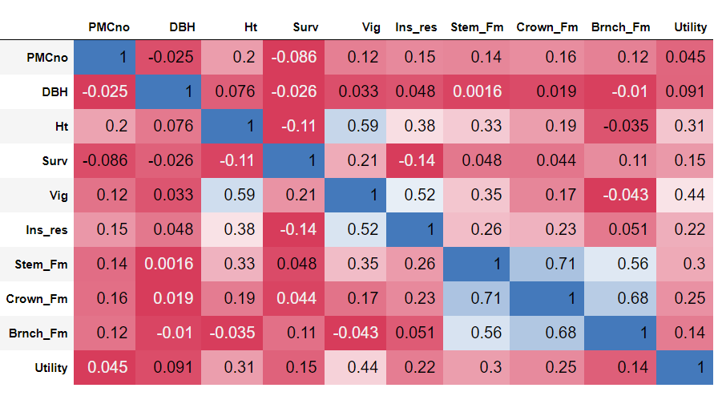
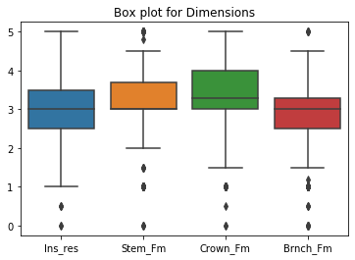
CORRELATION PLOT & BOX PLOT
CORRELATION PLOT
From the above correlation plot, we see Vig has strong correlation with Ht by 59% whereas with Ins_res its correlated by 52%.
Similarly, Crown_Fm and Stem_Fm is positively correlated by 71%. Also, Crown_Fm and Brnch_Fm is positively correlated by 68%. Additionally, Stem_Fm and Brnch_Fm is positively correlated by 56%.
Dependent variable Utility and Vig is positively correlated by 44% and Utility and Surv is positively correlated by 15%. Similarly, Utility and Ht is positively correlated by 31%, Ins_res by 22%, Stem_Fm by 30%, Crown_Fm by 25% and Brnch_Fm by 14%.
BOX PLOT
From the above graph, outliers can be clearly seen for Ins_res, Stem_Fm Crown_Fm and Branch_Fm as it is below the minimum value line. The outliers have values above maximum line for Stem_Fm and brnch_Fm. These outliers cannot affect the model and its accuracy of the estimators.

Slide 27
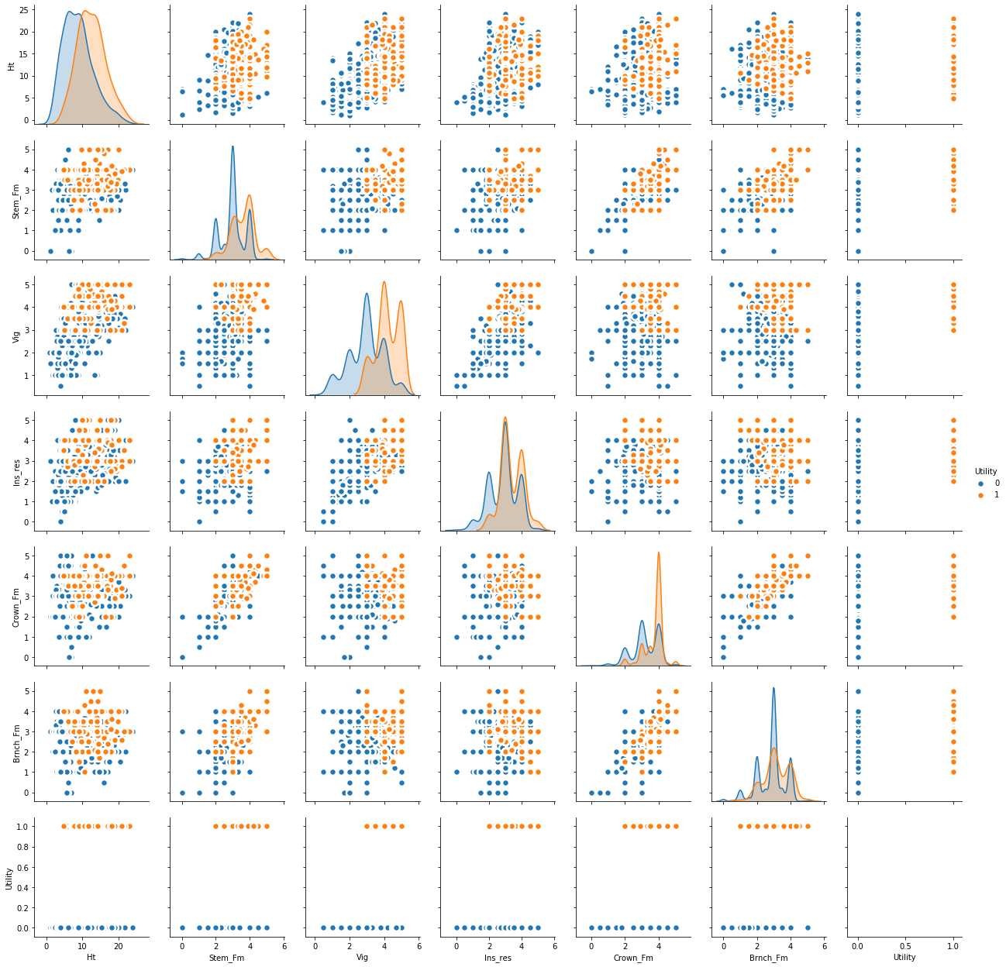
SCATTER PLOT
From the above scatter plot, we see that Crown_Fm has linear relationship with Stem_Fm and Brnch_Fm which means that they are highly correlated

Slide 28
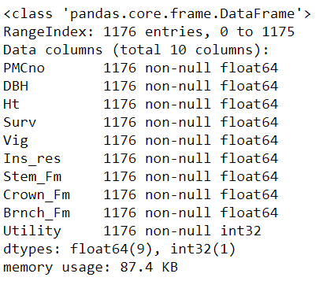
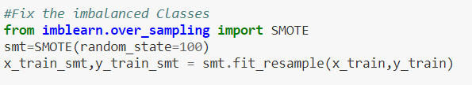
TUKEY METHOD
SMOTE
The dataset is reindexed and Tukey Method is used to eliminate outliers from the data. The data rows with more than outliers are dropped. The dataset after removing 158 rows now has below entries with data types
SMOTE generates a random set of minority class observations to shift the classifier learning bias towards minority class which is the best quality strains in this case. It is used with random state of 100. SMOTE is used to balance the data. It is noticed from the pie chart from the above visualisation that dataset is highly imbalanced.

Slide 29
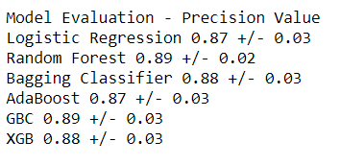
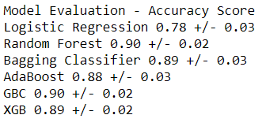
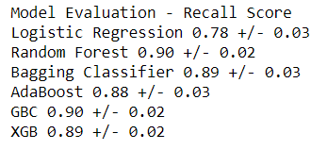
Comparison Model
For our base model, the model with highest recall value, precision score and accuracy score will be chosen, and the metrics show that
Random Forest has highest accuracy 90% ± 02%.
Bagging Classifier has highest accuracy 90%% ± 02%
Random Forest will be used as our base model and Random Forest with grid search will be used for analysis. The reason for choosing Random Forest Model is that it does feature selection automatically and the randomized parameters does not affect performance of model.

Slide 30
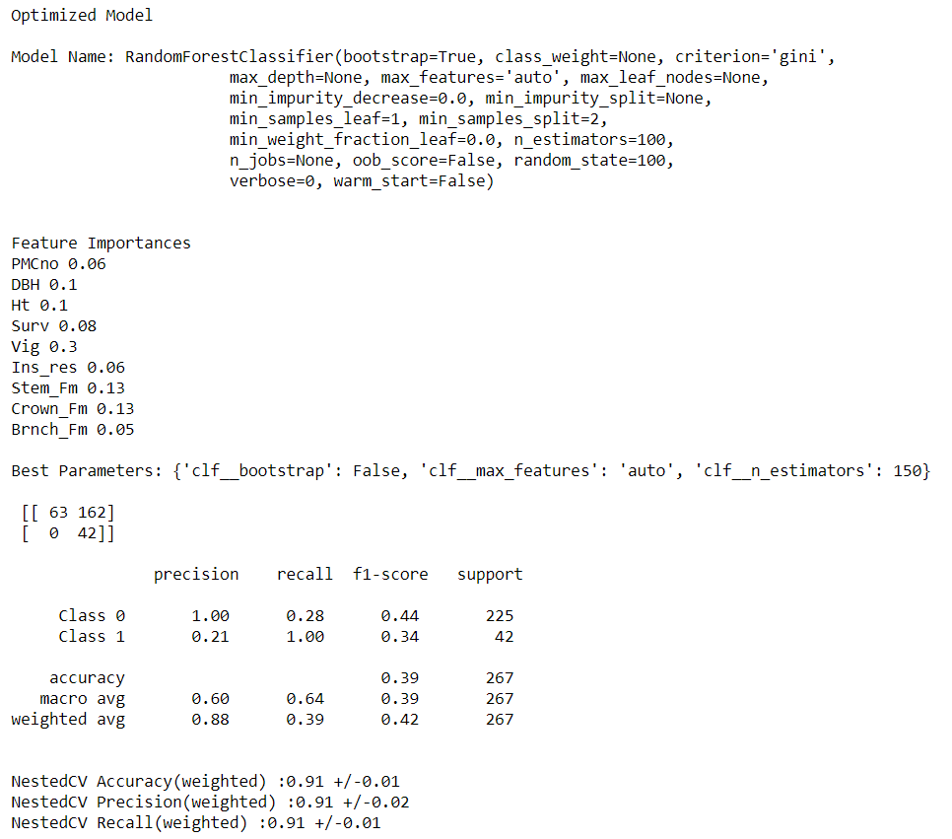
Results of optimized random forest model

Slide 31
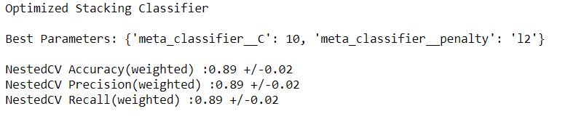
Results of stacking classifier model

Slide 32
Thank you

